Slide 1
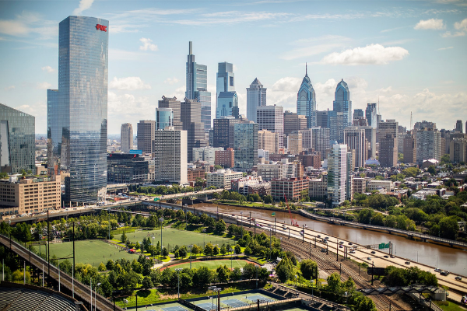
How to Survive Grad School
(Advice from a student who is supposedly surviving)
Sonia Lombroso
4th year, PGG, Bennett Lab

Slide 2
DISCLAIMER
01
QUICK LOGISTICS
02
OUTLINE OF TALK
FIRST YEAR ADVICE
03
GENERAL GRAD SCHOOL ADVICE
04
RECAP
05

Slide 3
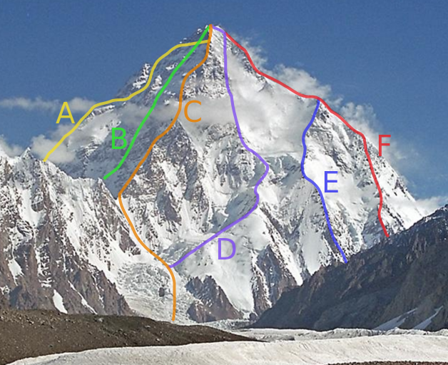
DISCLAIMER
Every PhD journey is different.
What do YOU want out of your time here?
Image Credit: Kogo Wiki
Notes:
You are coming in with different experiences, strengths, and future goals than your peers. Why would you measure your success based on someone else’s goals?

Slide 4
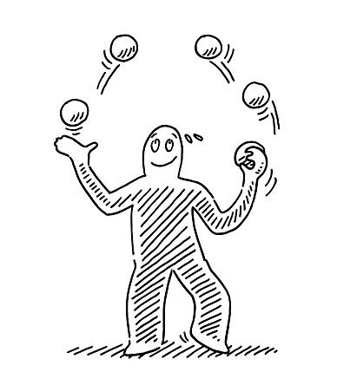
Coursework
Literature
Friends
Experiments
Mental Health
“The trick to juggling is to figure out which balls are made of glass and which are made of rubber.”
—Anonymous academic on twitter

Slide 5
Taxes
Reimbursement
Logistics
Health Insurance
Penn resources
In general, taxes are not taken out of your stipend. You can file quarterly or annual taxes. They are complicated and no-one within BGS will give you professional advice. If possible, talk to an accountant.
$1,000 per fiscal year for conferences (if presenting)
$1,500 per BGS lifetime to attend an off-site course
$1000 per BGS lifetime to attend a career-development conference
Other reimbursement resources available
Full-time students need coverage. If you enroll in Penn Student Insurance Plan (PSIP), it is covered by BGS. Vision (Aetna) and Dental (Penn Dental Student Plan) can also be fully covered. Take advantage of having health insurance, make your appointments.
Gym membership is free to PhD students.
Pool access, rental equipment, intramural sports
Counseling and Psychological Services (CAPS) available for free.
Peer counseling available 24/7 via Reach-A-Peer (RAP) Helpline

Slide 6
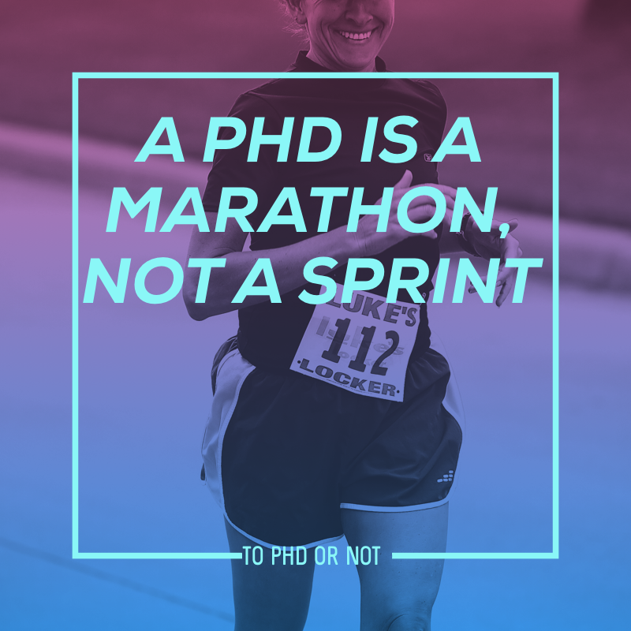
FIRST YEAR ADVICE
Classes
Rotations
Choosing a thesis lab
Extracurriculars

Slide 7
CLASSES
ROTATIONS
FIRST YEAR ADVICE
CHOOSING A THESIS LAB
CLUBS AND EXTRACURRICULARS
Do not mistake them for undergrad courses. They are designed for you to learn deeply, connect themes and integrate with your research.
Attend lectures. Talk to your TAs. Do not cram.
B is passing, although fellowships and certain jobs often request transcripts
Field/methods: Be open to exploring new areas and learning new techniques
Lab environment: Collaborative, competitive, 9am-5pm, or nights and weekends, size, age, trainee level, new vs established
Prior/current trainees: What do they say about the lab? Where are they now? What is the publication record? Does that matter to you?
Mentorship style: independence, feedback, communication, expectations (science, work-life balance)
What will your project be? Is it feasible within the time you hope to graduate in? Is it interesting to you?
Funding: Your stipend is guaranteed! But always talk about how the lab handles reagent requests, model organisms, number of technicians, etc.
Don’t overload your first semester or forget what your end goals are…
But, Penn is full of amazing opportunities and you should take advantage of that.
Clubs can promote your career development, but you’re also allowed to just do something because it is fun.

Slide 8
HOW TO INTERVIEW FOR ROTATIONS/LABS
Reach out to PIs via email, asap
Email etiquette is not a lost art
Set up meetings with multiple PIs
You should never feel pressured to accept a rotation or formal invitation to a lab in a single meeting
You should be honest if you are considering other labs
Prepare for the meeting
Do your homework!
Read faculty page
Read one or more recent papers, or at least abstracts
Talk to grad students who rotated or have joined
Be prepared to talk about your interests & expectations
Update your CV

Slide 9
ROTATIONAL INTERVIEW ADVICE
Show up on time
Let them know WHY you are interested
Be prepared to tell them about yourself, your schedule, your career goals, etc.
Questions to ask:
Research questions, obviously
Are you looking to take on a thesis student? How many students will you take this year?
Do you have space and money available for a Ph.D. student?
NIH RePORTER (http://projectreporter.nih.gov/reporter.cfm)
Will you be at Penn for the next 5-6 years? (if not tenured, or if being
recruited somewhere else!)
What projects are available in your lab?
What is your mentoring style? How often do you travel?
What are your expectations for your graduate students? Time in lab, time working, holidays, presentations/publications, academia/beyond

Slide 10
SUCCEEDING IN ROTATIONS
Remember, a rotation is for you to learn and to evaluate the lab as much as it is for the lab to evaluate you
Go to lab meetings and jclubs as much as possible
Show up when you say you will (a lesson for life)
Get to know the other members of the lab
Work hard but also work smart
Know what you are doing and why
‘An hour in the library can save you a month in the laboratory’
Read the background papers
Ask questions! Ask for help!

Slide 11
FINDING A GOOD MENTOR *FOR YOU*
Are your communication and work styles compatible?
Emails
Meeting frequency
Hands-on/off
Comfortable talking
Mentoring style
Academia or bust?
Willing to talk about life or just science?
Conference attendance
Help networking
Mentors outside of your PI
Post-docs/Colleagues
(Future) committee members
PIs at other institutions

Slide 12
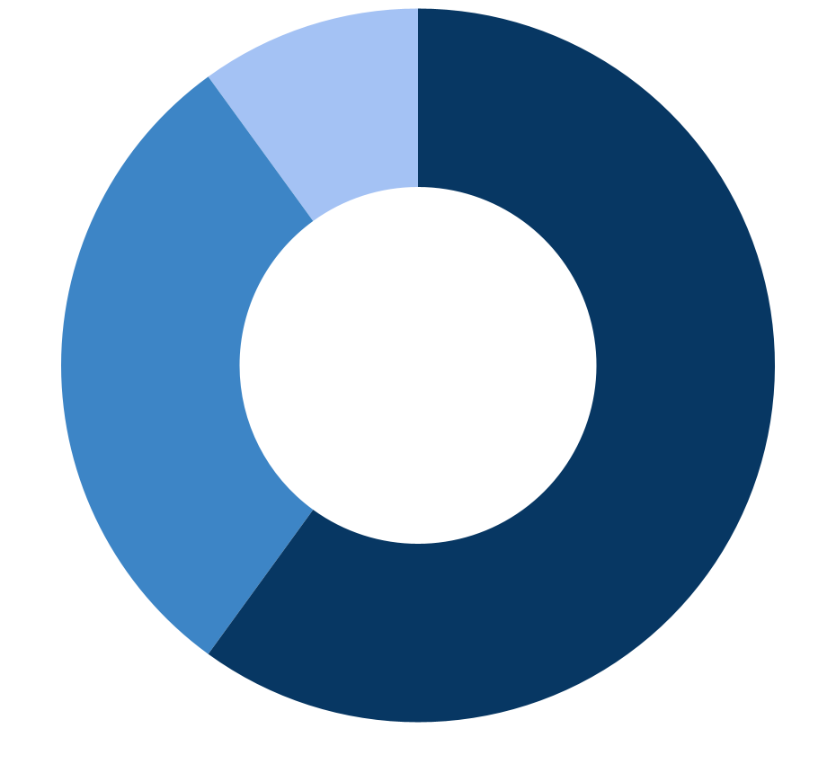
WHAT MAKES FOR A GOOD PHD LAB EXPERIENCE
(my two cents)
ENVIRONMENT
60%
SCIENCE
30%
LUCK
10%

Slide 13
GENERAL GRAD SCHOOL ADVICE
Organization
Learning outside (or inside) the classroom
Read the literature
Apply for fellowships
Building your network
Work-life balance

Slide 14
Time Management
Data Management / Lab notebook
Planning, Planning, Planning
ORGANIZATION
Keep a calendar for lab, classes and meetings
Managing UP
Map out how long you *think* something will take, and multiply by 1.5. That’s how long you should allot yourself
Keep an eye on big deadlines and add in buffer time those weeks – exams, lab meeting presentations, rotational talks
Make good habits, early. Find what works for you. This will save you A LOT of headache later
Use an online lab notebook in addition to whatever your PI requires - lab archives, benchling
Don’t forget to keep track of negative data (even if you’re sad about it)
Backup your data!! Get an external hard drive, cloud storage or preferably both. Use them CONSTANTLY - PennBox, Dropbox, Google
Daily: What is your intention for that day? What are must do items? What are should do items? What can wait? What can’t?
Weekly: Have a weekly ‘planning’ day where you map out the experiments for the next week
Gather and read the protocols you will use that week
This will help you ensure you have all the needed reagents, including time
Monthly/Bi-monthly: Check-in with your PI/lab mentor. Are you on the same page about goals and priorities? What is the rough outline of what you hope to achieve that month?
Yearly: Individual Development Plan (IDP) meetings with your PI. What worked that year? What do you need more or less of next yeat?

Slide 15
LEARNING INSIDE (and outside) THE CLASSROOM
What additional skills/training will you need for your project?
Statistics – classes available
R/Stata/MATLAB – free access
Prism – free access through Penn
Adobe Photoshop/Illustrator – free access through Penn
DIY-transcriptomics https://diytranscriptomics.com
Other field specific
You can take courses outside your department (with permission)
After candidacy
Must be over 400 level
One per semester

Slide 16
READING THE LITERATURE
You gotta do it
Make time to read, but use that time efficiently
Read abstracts/glance over figures to decide what’s worth your time
Organize your PDFs and use a citation manager
Endnote, Papers, Mendeley, PaperPile, Readcube, Zotero
Stay up to date with your field
PubCrawler, Google Scholar Alert, Readcube Recommendations, Twitter & other social media, BioRxiv
Try to avoid endless tabs of doom

Slide 17
APPLYING TO FELLOWSHIPS
National Fellowships:
NSF and NIH NRSA (F31/F30)
HHMI Gilliam Fellowships (underrepresented groups in science)
Ford Foundation Fellowships
DoD SMART Fellowships
Penn Specific:
Training grants (T32) are a great experience – talk to your programs about what ones are available for you and their requirements
Gloria Chisum Graduate Fellowship (nationally underrepresented populations)
Blavatnik Family Fellowship
Penn Prize for Excellence in Teaching by Graduate Students
GAPSA-Provost Fellowship for Interdisciplinary Innovation
Grad Center at Penn keeps a ‘Highlighted Opportunities’ page
Talk to your PIs about their expectations for your funding (though it is guaranteed)

Slide 18
APPLYING TO FELLOWSHIPS
Recommendation letters:
Keep in touch with your former PIs and do a good job in your rotations!
Ask at least 1 month in advance. Include CV in email
Keep an eye on deadlines and ask for what you need well in advance
Keep summaries of your undergraduate/technician/lab rotations
Talk to students who have applied to/gotten these fellowships
Your program administrators will often know who has successfully applied and be able to provide you with examples
Apply even if you don’t think you’ll get it, especially to the random ones

Slide 19
BUILD YOUR NETWORK
For Support
Grad school is not a scarcity of riches
Make friends. Lean on these people when you need it, be there for them when they are having a hard time.
Ask an older student/trainee to go for coffee
For Science collaboration
If you can help, help
Share protocols and reagents (with permission)
Collaboration is reciprocal
For Career opportunities
Keep your professional social media somewhat up-to-date
‘Thank you emails’ after meeting someone you think you’d like to maintain a relationship with in the future

Slide 20
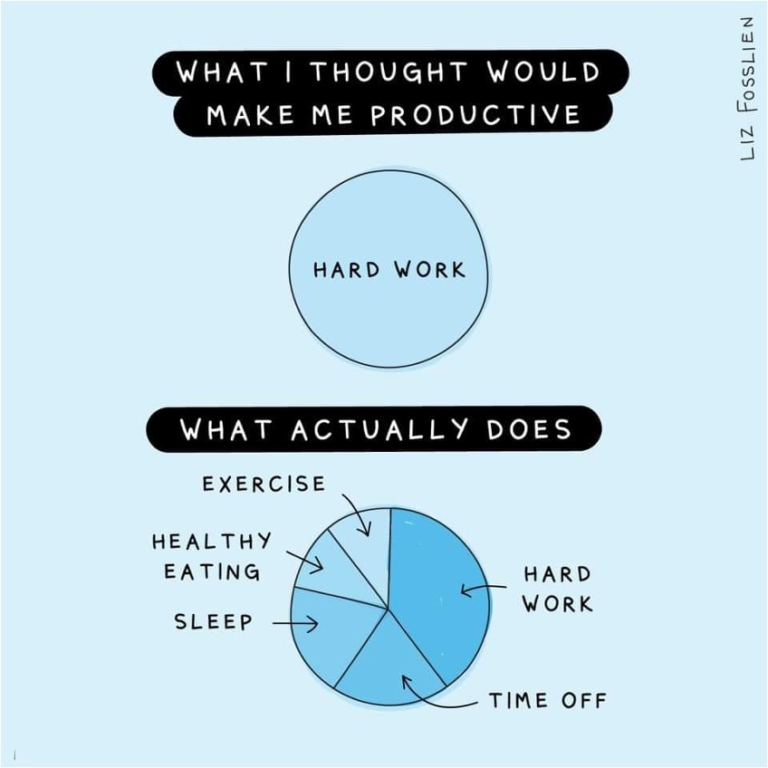
WORK-LIFE BALANCE
You are salaried – remember to give yourself vacations and weekends
Keep doing things you love
Maintaining your health is important (whatever that looks like)
Sleep, see family, make friends, explore Philadelphia

Slide 21
FOOD
OUTDOORS
ARTS
SOCIAL
EXPLORE PHILADELPHIA

Slide 22
TAKE HOME MESSAGES
Choose your mentor(s) wisely
Figure out systems for time, data, and literature management
A Ph.D. is about learning
This happens in waves
Make networks - friends, mentors, peers
Work/life balance is key - make time for yourself and friends
This is a large chunk of your life
REMEMBER TO ASK FOR HELP

Slide 23
I BELIEVE IN YOU
Reach out to me with questions!!
Lombroso@pennmedicine.upenn.edu
@Sonia_Lombroso
Sonia Lombroso on LinkedIn

Slide 24
MORE RESOURCES
“The importance of stupidity in scientific research” Martin A. Schwartz, Journal of Cell Science, 2008, 121:1771
http://jcs.biologists.org/content/121/11/1771
How to Complete and Survive a Doctoral Dissertation, Sternberg, David, N.Y.: St. Martin's Press, 1981
Getting What You Came For: The Smart Student's Guide to Earning a Master's or Ph.D., Peters, Robert L., N.Y.: Farrar, Strauss & Giroux, 1992
“Graduate School: the movie” Cori Bargmann, Current Biology, 1995, 5(7): 695
Twitter/Facebook: ShitAcademicsSay @AcademicsSay
http://phdcomics.com/

Slide 25
CREDITS
This is where you give credit to the ones who are part of this project.
Presentation template by Slidesgo
Icons by Flaticon
Infographics by Freepik
Images created by Freepik

